Slide 1
Image Processing
Histograms
James Connan

Slide 2
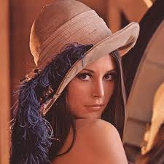
Len(n)a Söderberg

Slide 3
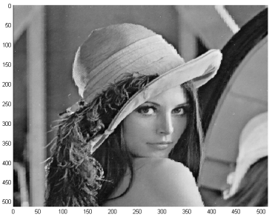
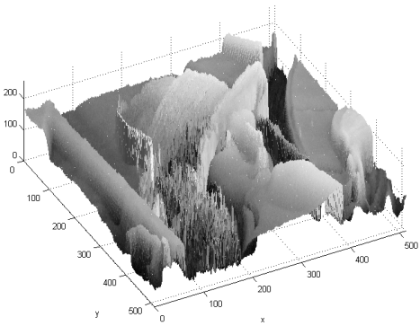
Histograms

Slide 4
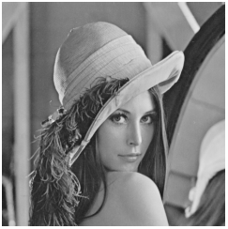
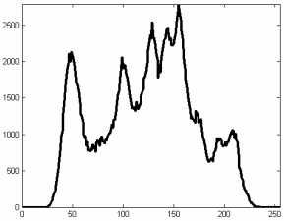
Histograms
Frequency of each pixel value in the image
Grayscale image it is the number of pixels in the image with each pixel value
Can be expressed in terms of fractions or ratios

Slide 5
Histograms
Histogram calculation
  Iterate through every pixel in the image
    Count how many pixels there are for each value

Slide 6
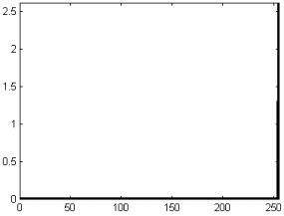
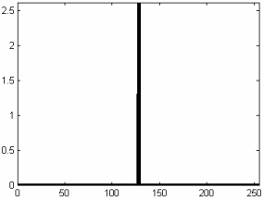
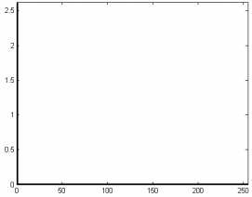
Histograms

Slide 7
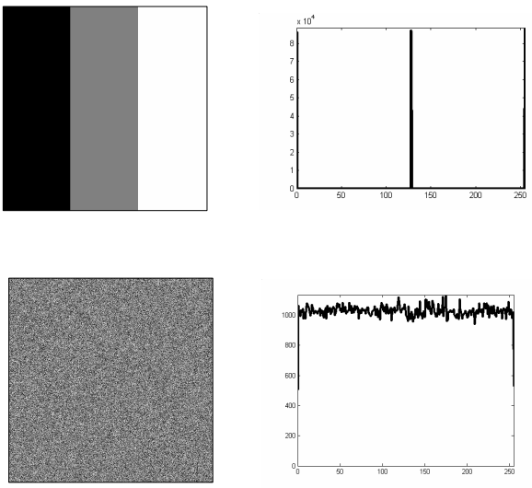
Histograms

Slide 8
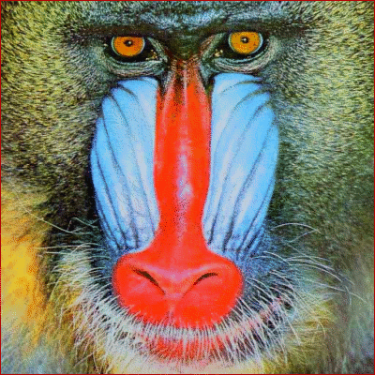
Meet baboon

Slide 9
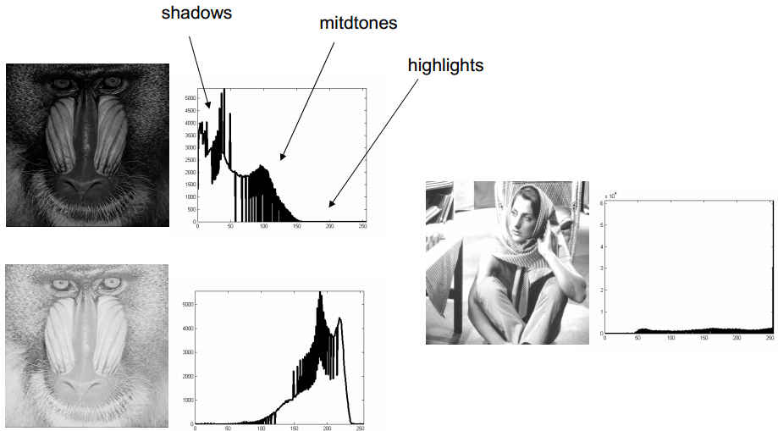
Histograms

Slide 10
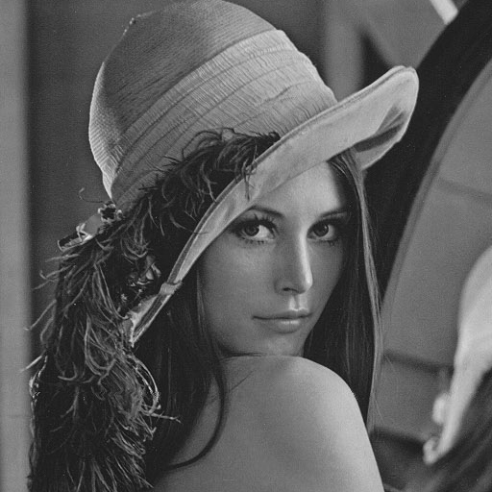
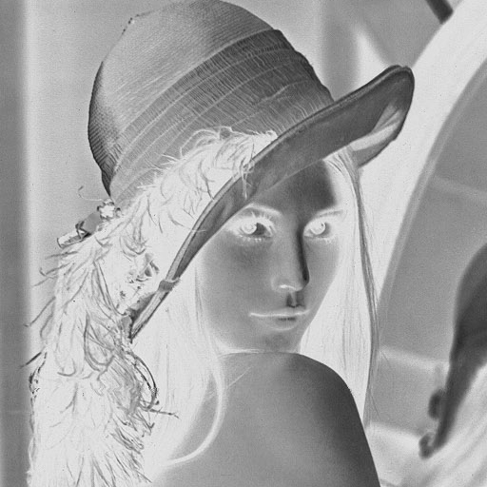
Histogram
Negative
  255 - pixel

Slide 11
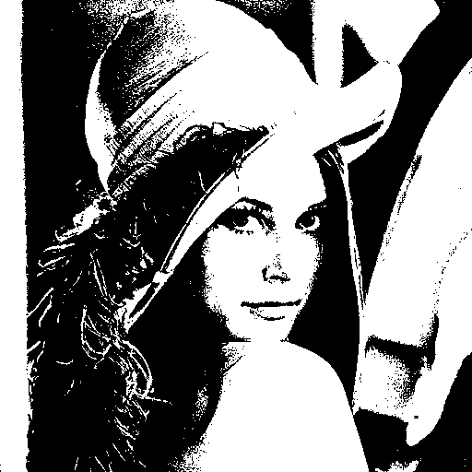
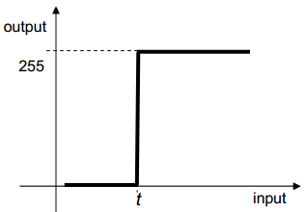
Histograms
Threshold

Slide 12
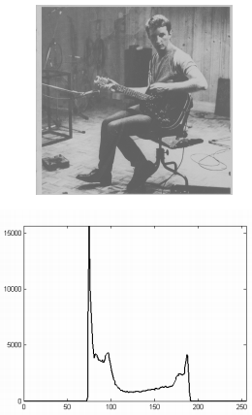
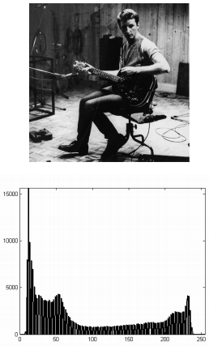
Histograms
Stretching
  Map into unused levels

Slide 13
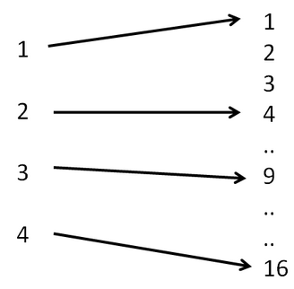
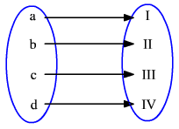
Histograms
Mapping onto new range

Slide 14
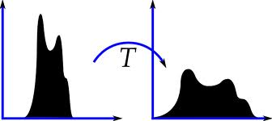
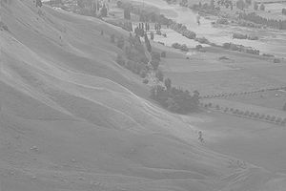
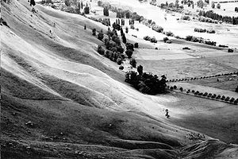
Histograms
Equalization

Slide 15


Histogram – Equalisation
Equalisation
Histogram normalized to [0,1]
Cumulative distribution function
Transform cdf to be linear
New image {y} in range [0,1]
Scale

Slide 16
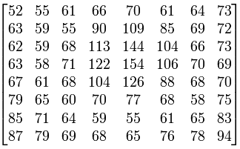
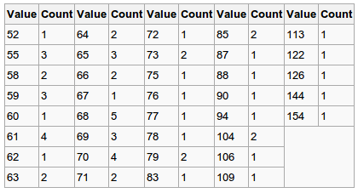
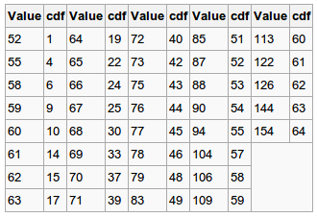
Histograms
Example

Slide 17


Histograms

Slide 18
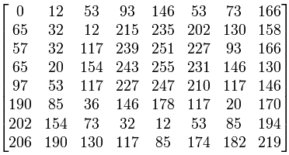
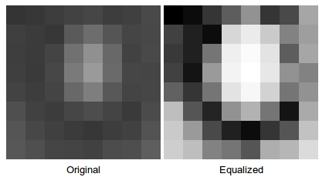
Histograms

Slide 19
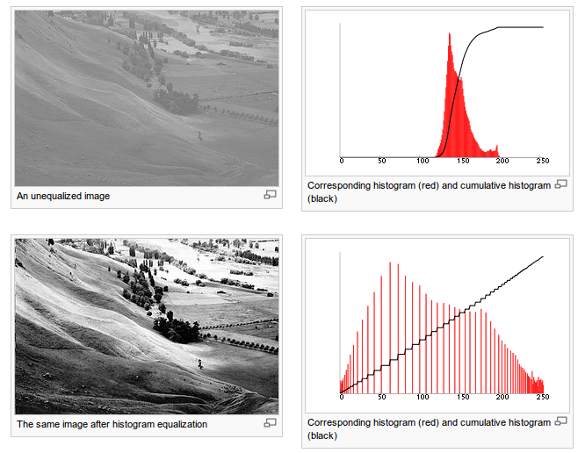
Histograms

Slide 20
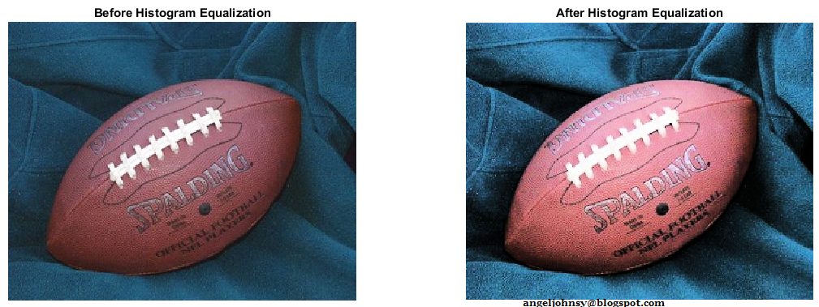
Colour images
Change RGB → HSV/I
  Apply to V/I

Slide 21
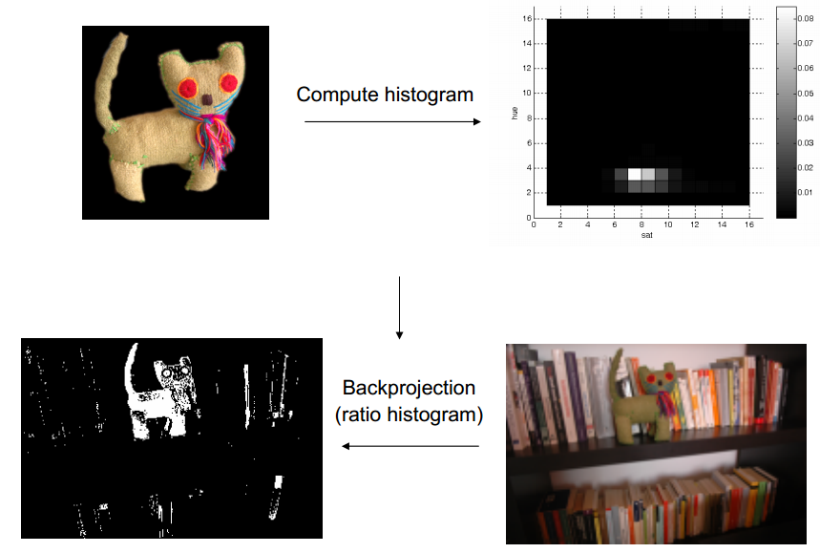
Histograms
Object detection

Slide 22
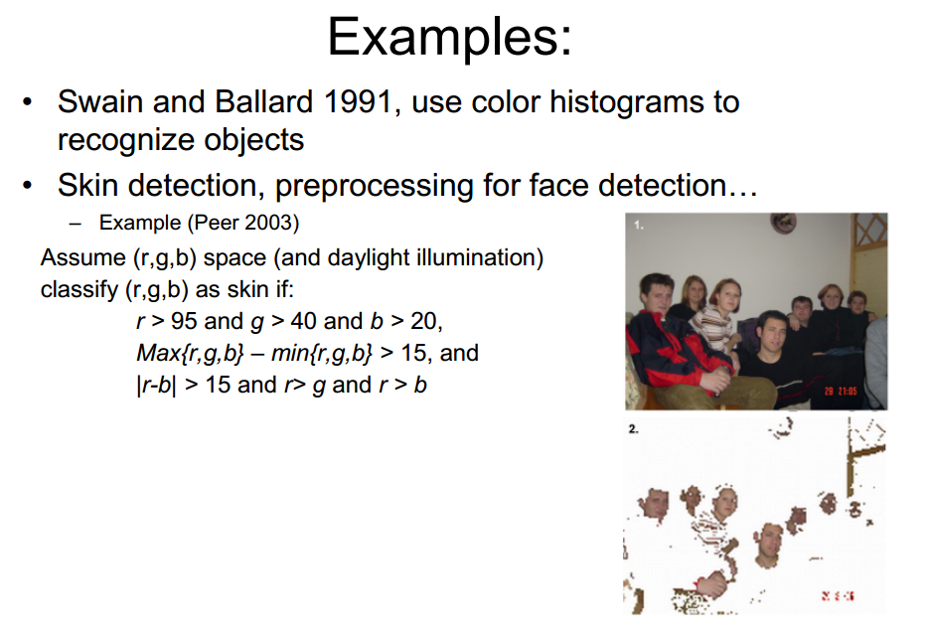
Histograms

